Slide 1
MRC DTP in Precision Medicine Graph Based Methods to Identify Drugs and Metabolites in Stroke Patient Urine
Francesca Young

Slide 2
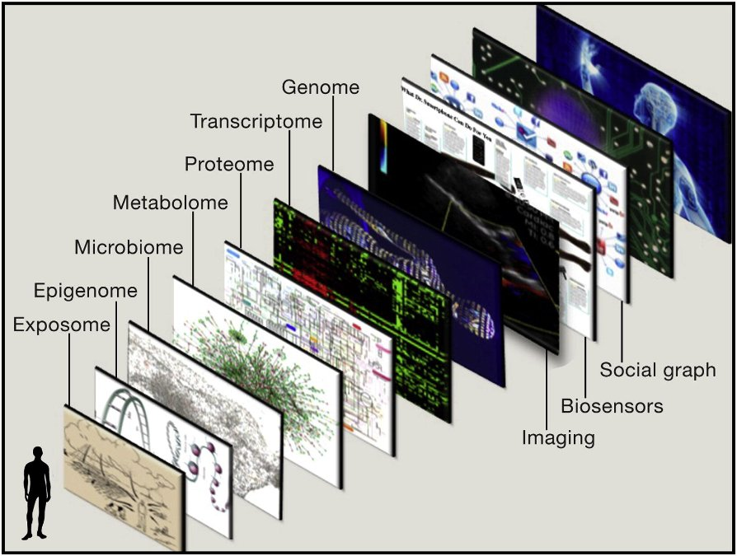
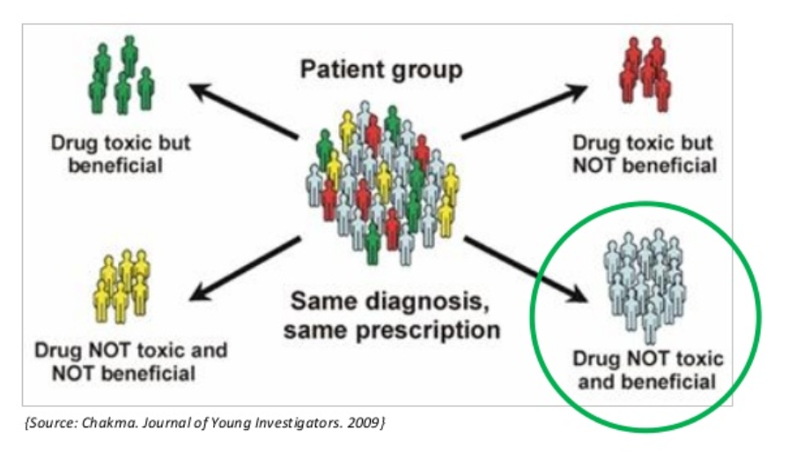
Precision Medicine
Big Data . Big Challenge
Growing gap between our ability generate big data and ability analyse and
interpret it.
Need for a new generation of bioinformatics and anaytical tools.
Stroke - fourth biggest cause of death, largest cause of adult disability.
Notes:
PM is about giving the right patient the right treatment at the right time at the right time. Major implications to patient outcomes and costs
Enabled by massive biomedical data sets, omics data, electronic health records ,biobank data.
New generation tools required using efficient algorithms for extracting knowledge hidden within the data
.
This project is about increasing our understanding inter-individual differences in drug disposition,
Strokes are the fourth biggest cause of death and the biggest cause of adult disability cost the country,
There are currently several treatment stratergies used on stroke patients

Slide 3
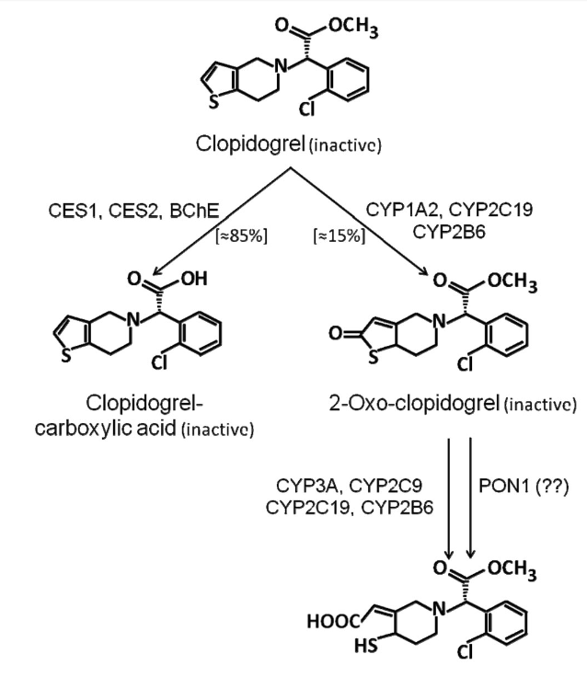
Drug Metabolism
Enzymes evolved to deal with toxic substances ingested .
Process of converting a lipophilic molecule to polar molecule.
Phase 1 and phase 2 .
Process can activate or deactivate of drug.
Most DME have clinically relevant polymorphism.
Pharmacogenomics complicated by other factors lifestyle/environmental/microbiota.
We take a different but orthogonal approach.
Clopidogrel
Notes:
Evolution –
Process – biotransformation of a xenobiotic compound to enable excretion.
Phase 1 breaking down hydrophobic groups, Phase 2 adding polar groups
DME polymorphisms , include SNPs. INDELs copy number variation.
Pharmacogenomics study affect of genome on drug metabolism
not a simple link from genome to drug metabolism.-
a single gene mutation can affect a wide range of metabolomics pathways.
Complicating factors- environmental and -age , diet, alcohol , drug-drug interactions
Using a complimentary approach - metabolomics

Slide 4
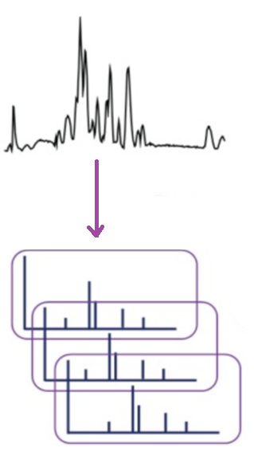
Metabolomics
Metabolome is directly linked to phenotype.
Untargeted metabolomics aims to analyse entire metabolome within a biological system.
Urine contains metabolic breakdown products from
foods and drinks, drugs, environmental contaminants,
endogenous waste metabolites.
LC/ MS Fragmentation data –each metabolite gives rise to characteristic fragmentation pattern.
Major challenge is peak annotation
(van der Hooft et al., 2015)
Notes:
Metabolomics is the endpoint of the central dogma and is directly linked to phenotype, actually represents what is happening in the cell.
Use as orthogonal data to genomics to give new insight eg sickle cell anemia. SNP known for 50years, metabolomics discovered metabolite involved enable a hypothesis about mechanism to be tested.
Annotation a major challenge for untargeted metabolomics. Need for Development of new rigorous and reliable annotation methods tools required to remove this bottle neck.

Slide 5
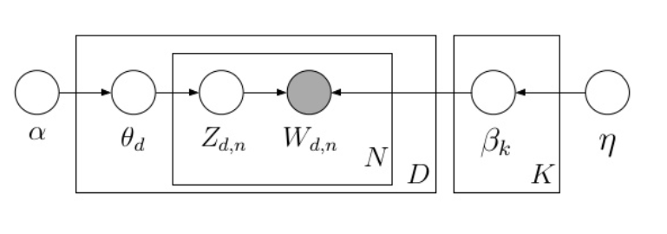
Latent Dirichlet Allocation Blei,Ng,Jordan 2003 (cited 15000+ times)
Well establish use in natural language processing.
Topic Modelling , a Bayesian unsupervised learning model.
Three goals of topic modelling
Uncover hidden topics
Annotate the document according to the topics contained
Use the annotation to organise and summarise documents.
Notes:
The goal of LDA represents documents as a mixture of topics.
It backtracks from the words into the documents to find the set of topics that is likely to have generated the document.
The observed variable are the words and the hidden or latrent variables are the topic structure and generative process that produced the data.
From a collection of documents, infer
Per-word topic assignment zd,n
Per- document topic proportions ϴd
Per-corpus topic distributions βk
Documents are the set data for a sample
Words are the individual peaks.
Topics are the unknown metabolites from which the fragments came.

Slide 6
Intended Outcomes of the Project
The goals the general aims of this project are in knowledge discovery of insights into the inter-individuality of drug metabolism.
Develop a novel computational tool annotate previously unannoted metabolites from LS/MS data.
Identify potential biomarkers to link metabolites present to patient response.
Gain knowledge of how environmental and lifestyle factoreslinking drug metabolism/treatment outcome to other exogenous and endogenous metabolites.

Slide 7
MSc Project
ML/Metabolomics
MSc Bioinformatics
Omics, Molecular Biology
Systems Biology Drug Discovery Programming Data Base Theory
MSc Information Technology
Programming Systems Design, Communications Theory Electronics
BSc Biophysics
Molecular Biology, Protein Crystallography, NMR, Quantum Mechanics, Physics, Mathematics, Organic Chemistry
My Knowledge
Base

Slide 8
Skills
Experience
Project Management Skills
Organisational Skills Problem Solving
Time Management Analytical skills
Leadership
MSc Bioinformatics
Research Assistant Bioelectronics
Computer Skills
Programming JAVA, C, Python, R.
Software Development Wide range of projects
Bioinformatics Pipeline Scripting, Awk, UNIX
Data Base Development SQL, interface to JAVA
Research Assistant Protein Crystallography
Running my on Business
Communication Skills
Report writing
Presentations
Collaborating
Voluntary Community work
Training and Development SVQ lll

Slide 9
My Motivation
Always drawn to back to biological sciences.
MSc Bioinformatics opportunity to update and build my knowledge .
Looking to focus on the use of machine learning in bioinformatics.
The application of machine learning in precision medicine is a way to has potential to have a major impact on patients lives.
Notes:
Strengths in math and physics but switched from engineering to biophysics as that is where my interests lie.
MSc has been opportunity to build update to update knowledge and skills. Learning with access to internet is an amazing experience, suits my learning style.
Over the course of this I have noticed that the bioinformatics methods used are not always the most rigorous available but often chosen by what is known.
Seen it could be hugely beneficial to import methodologies well established in other area eg signal processing (Chip Seq), communications theory microarray data) but what has really sparked my interest is the potential of machine learning. These methods well established by the likes of google. Facebook and amazon. These algorithms have massive potential impact on our ability to extract information and integrate biomedical data
I am highly motivated by the idea of applying machine learning in precision medicine where it is targeted to clinical need and has the potential to make a real difference to patients lives

Slide 10
My knowledge and abilities are well matched to enable me to contribute to
Developing the next generation of bioinformatics tools.
Understanding the biological and medical implications of results generated.
My motivation
I am highly motivated to pursue a career in biomedical research.
I am prepared to work extremely hard to achieve my goals.
I am committed to make the most of any career development opportunities.

Slide 12
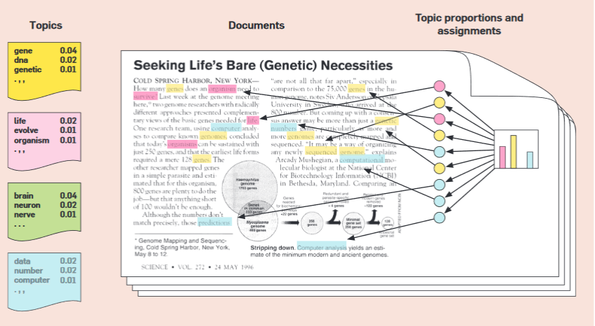

Slide 13
